Slide 1
Predicting Playtime on Steam₂
Taha Ahmad
Notes:
Hello everyone, I’m Taha Ahmad and I’m going to talk a little about the statistical analysis I did on predicting playtime on Steam.

Slide 2

What is Steam?
Notes:
To start off with, let’s define what Steam is so my presentation can actually be understood.
Valve corporation’s Steam is the most popular store front for digital computer games. Nearly every video game that is released these days which supports being played on computers will be listed for sale on Steam. Valve also provides robust API access to stats regarding both players and games for developers to utilize. This makes it ideal for gathering data on sales and engagement about video games.
The crux of my project is approaching from the perspective of someone marketing their software on Steam, we want to make a data driven analysis to attempt to answer:

Slide 3
What are we trying to answer?
What factors lead to the success of a game on the Steam storefront?
Success being defined as a high user engagement, or a high median playtime in hours of users who consume the software.
Notes:
What factors lead to the success of a game on the Steam storefront. With success being defined as a high user engagement, or a high median playtime in hours of users who consume the software.

Slide 4
Predicting Playtime on Steam₁
Notes:
Now this project is actually an extension of my DATA 606 project which tackled the research question specifically on if user ratings were related to median playtime on Steam. Since the previous project is essential to this project, I will explain the summarized version.

Slide 5
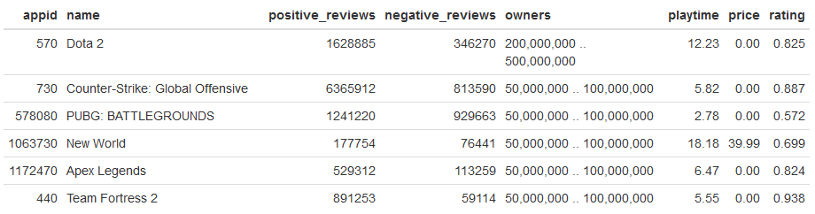
The Data
Notes:
I extracted data from the Steam Spy API which gave me a variety of information about the applications such as the amount of reviews, the amount of owners, the price of the games, and the playtime.
In R I had processed this data to calculate the user rating, factorizing the owner category, and converting playtime to hours.

Slide 6
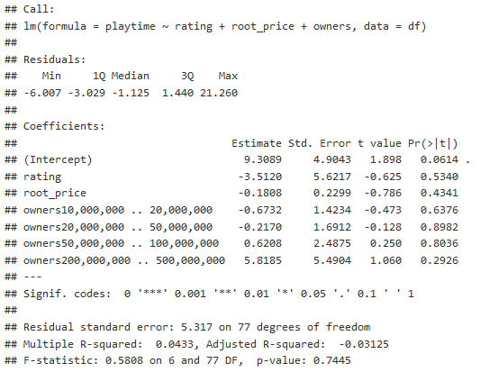
Multiple Regression₁
Notes:
The data was then processed to attempt to make the best multiple regression model I could with the data that I had. Unfortunately with the data on hand the best multiple regression model I could make shown above, had a negative adjusted R-squared value! This meant our initial research question ended on: The user ratings, reported by Steam, are not related to median playtime based on creating a regression model from the data.

Slide 7
Predicting Playtime on Steam₂
What predicts higher median playtime (engagement) for games on Steam?
Notes:
Now we want to take our existing data and work on top of it to answer a more generalized question, as to what would predict higher median playtime for games on steam?

Slide 8
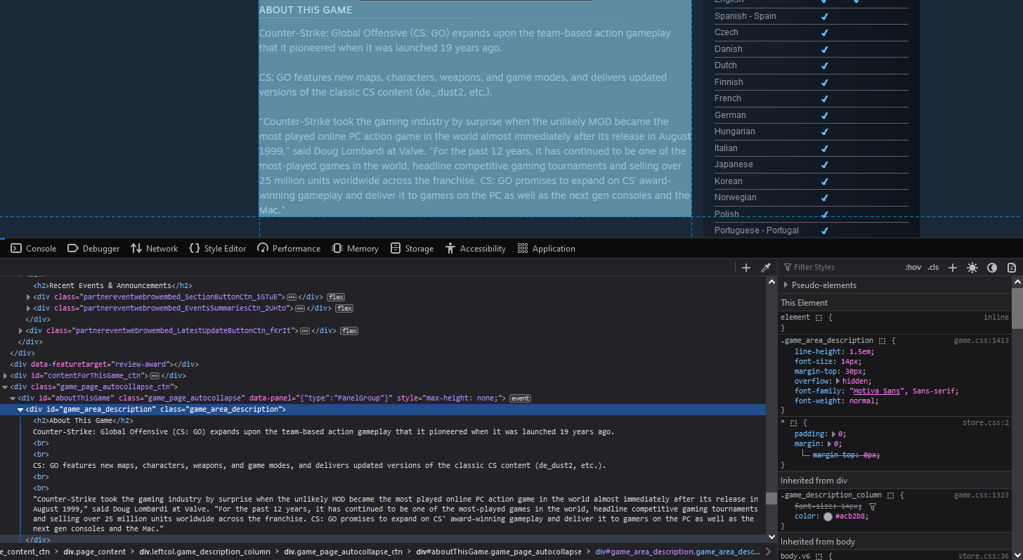
The New Data
Notes:
In order to extend the previous project I needed extra data to use for new predictors.
Ideally the predictors would be different enough between game to game to allow for fitting a model to it while also accounting for the reasons someone may play a game more often.
I settled on the game description within the Steam website itself, I was going to programmatically scrape the data for each AppID within the dataframe I had previously gotten via SteamSpy API.

Slide 9
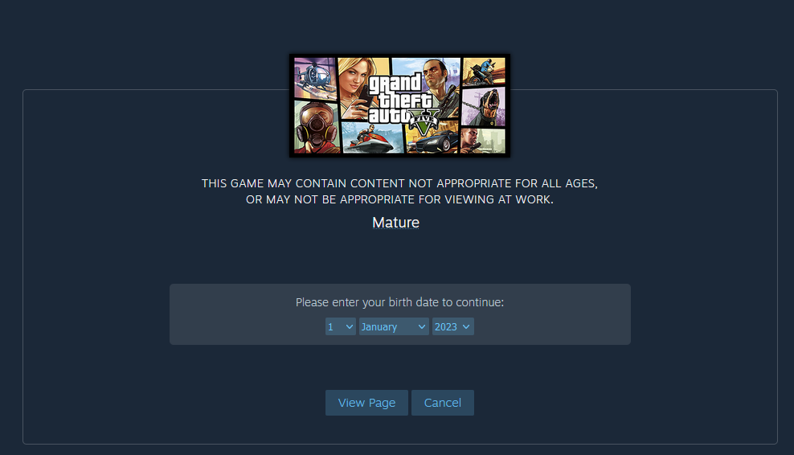
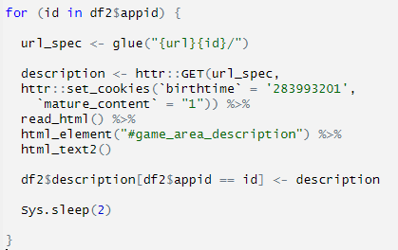
A Roadblock
Notes:
Thanks to the URL structure of Steam being very simple, I was easily able to loop through the store pages of each game I wanted to collect data on. However, I noticed that about 12 or so games ended up with an empty description value. Looking through the variables I had set in the loop, I saw the problem being that the HTML for these pages was completely different than the other pages.
The reason being these games had age restrictions due to being deemed as having mature content. I needed to get around the age restriction somehow while still within my for loop. The way I managed was by adding httr’s GET on top of rvest’s read_html , as GET allows you to set cookies. However, figuring this out was a bit of a tough time. It turns out cookies are kept with your birthdate and if you want to view mature content that allow for viewing these pages.

Slide 10
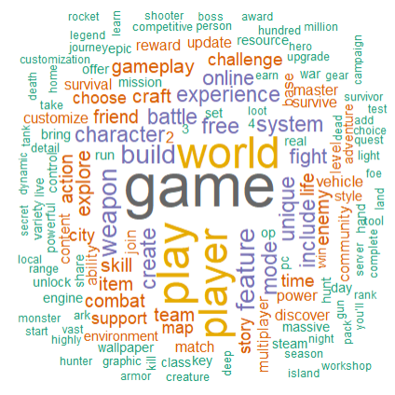
Tokenization
Notes:
Ultimately, the goal was to break the description down into tokens grouped by each game. Here we have a word cloud from the aggregate of the tokenized descriptions after removing stop words and changing terms to the root.

Slide 11
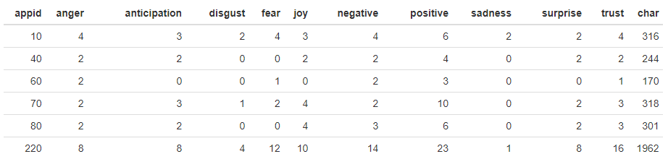
Sentiment Analysis
Notes:
I proceeded to load in the NRC emotion lexicon. This lexicon provides us with 8 different human emotions that are mapped to specific words along with a general sentiment of positive or negative as a category.
I took this lexicon and joined it to our tokenized descriptions, then counted values grouped by both the appid and sentiment to get the amount of words that fall into each emotion or sentiment per app.
Afterwards, I pivoted the dataframe to have each application as a row which will be necessary for our predictive models. The new data that we want to analyze is essentially as shown.

Slide 12
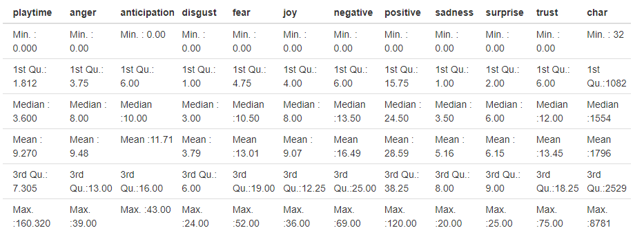
Summary Statistics
Notes:
The data as a whole is surprisingly much better distributed at first glance than the data from the previous project.
For the most part, each sentiment column is close in median and mode, indicating little skewing. However, we anticipate a floor effect at 0 causing slight rightward skews in each instance.
Additionally, as there are large rightward outliers such as a count of 120 positive words in the max instance. This means that there are large outliers within those categories that we might want to deal with to prevent our regression model from not being generalizable.

Slide 13
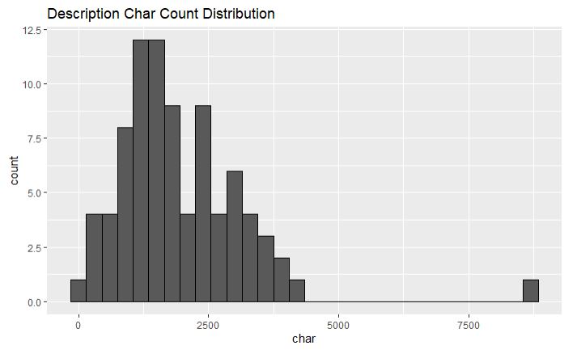
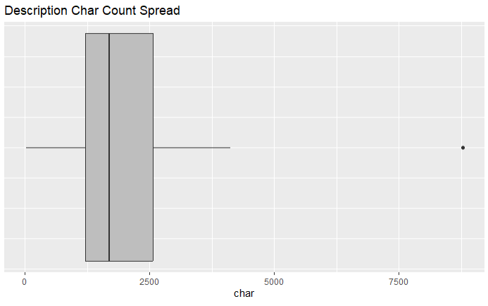
Distributions and Outlier Removal
Notes:
I looked at the new variables for skewness and outliers. For example: Looking at the histogram and boxplot for the character count of the description we notice one simply egregious outlier present. With triple the value of our third quartile. This is a prime target for outlier removal. This gets processed and removed

Slide 14
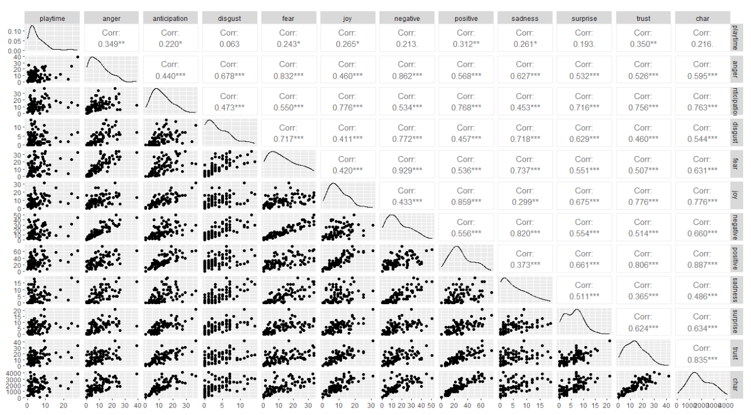
Pair Plots
Notes:
Finally, we’ll take a look at the pair plots for determining if we have colinearity between variables.
Perhaps unsurprisingly, the sentiments are very correlated with each other. As we have correlations greater than 0.50 for nearly every pair of sentiments.
It’s especially noticeable looking at something like the correlation of 0.9 between fear and negative count.
The assumption of colinearity being violated should be kept in mind for our new models.

Slide 15
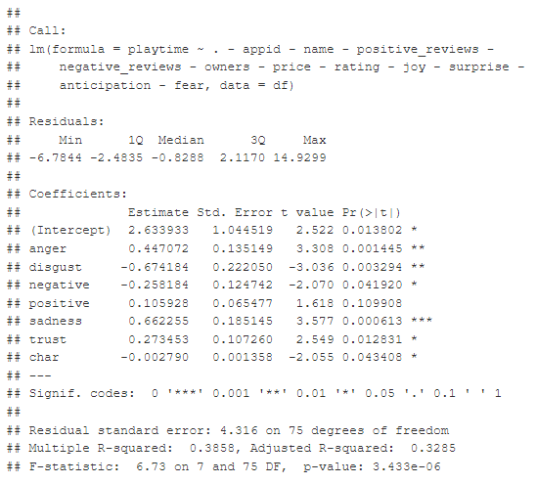
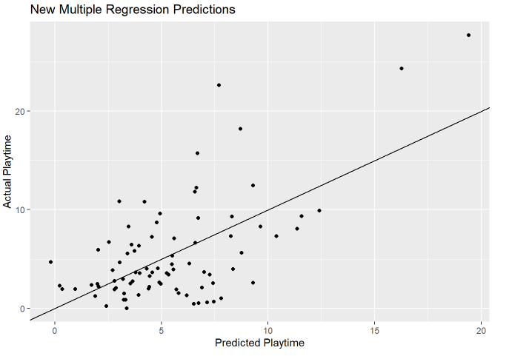
Multiple Regression – New Predictors
Notes:
We first approach this analysis by making a multiple regression model between our sentiment analysis variables and playtime. Our most powerful predictors include sad words and angry words in the description. For each sad word in the description our regression model says median playtime will go up by 0.66 hours, while for angry words playtime will go up by 0.44 hours. However, disgust is a powerful predictor in the other direction. For each word with a sentiment of disgust associated with it players will play -0.67 hours less.
Looking at the goodness of fit with the adjusted R-squared value. At 0.3285 we know that the model only accounts for 33% of variation in the data. However, with our overall p-value at 3.433e-06, we are almost certain then the utilizing this regression model is better than randomly guessing. It should be noted that although not show here, we have violated every assumption for regressions so the information provided should not be used.

Slide 16
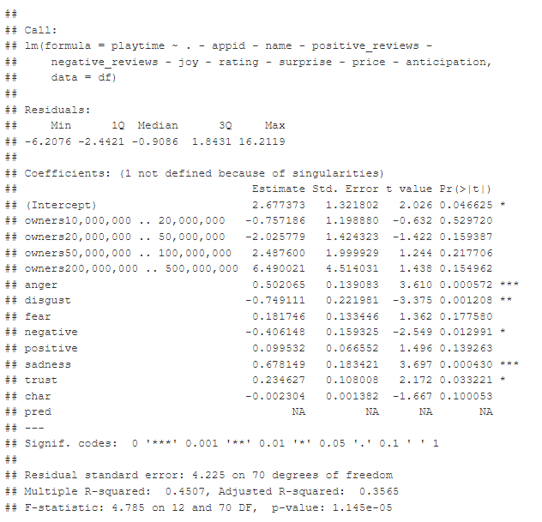
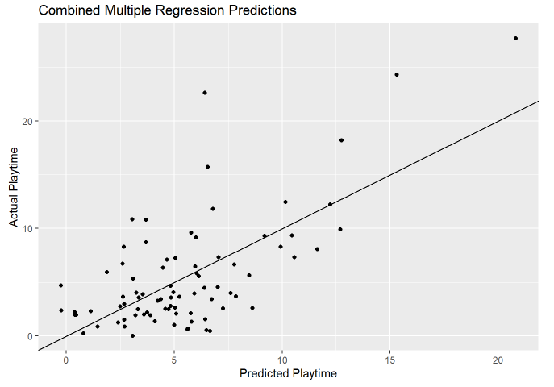
Multiple Regression – Combined Predictors
Notes:
We next see if we can improve our multiple regression model by adding in the variables gathered from the previous project.
Our most powerful predictors again include sad words and angry words in the description again. For each sad word in the description our regression model says median playtime will go up by 0.68 hours, while for angry words playtime will go up by 0.50 hours. However, disgust is a powerful predictor in the other direction. For each word with a sentiment of disgust associated with it players will play -0.75 hours less.
Looking at the goodness of fit with the adjusted R-squared value. At 0.3565 we know that the model only accounts for 35% of variation in the data which is an increase from the final state of our previous model. The residual standard error has also gone down to 4.225 hours. However, our overall p-value has gone up to 1.145e-05, which is still significant.
Note once again all multiple regression assumptions are violated.

Slide 17
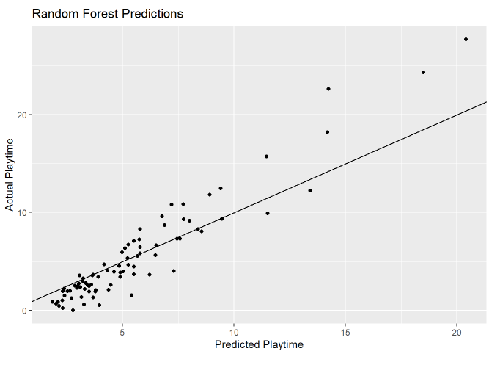
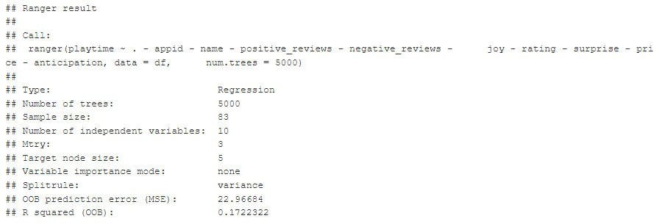
Random Forest
Notes:
For my last model, I decided to attempt something that we have not learned in class. That being a random forest model. A random forest model is a type of decision tree learning where multiple decisions trees are repeatedly made by random chance finding one that is the most optimized. After creating our random forest tree, we can see that we’re getting an R squared of 0.17. The random forest ends up being worse at accounting for variation than the previous two regression models. However, it is still better than the negative r squared from the first project.
Notice the random forest predictions have a much tighter spread compared to the multiple regression models. However, because of this tighter spread the residuals balance out less leading to a worse prediction error (Mean Square).

Slide 18
Conclusion
Significant coefficients suggested to increase retention developers should focus on crafting their description with words that evoke:
Anger
Sadness
While avoiding words that evoke:
Disgust
Results are invalid as assumptions have been violated
Notes:
Our best two models had significant coefficients that suggested that video game developers who are looking to list their games on Steam should focus on loading their description with words that sounds angry and sad, while avoiding words that sound disgusting in order to maximize user retention according to our flawed model. However, these factors should not be considered as even associated with success as the assumptions used to build each model were violated, this renders the information found from the models not valid.

Slide 19
References
Yun Yu’s Harvard post was used for the introduction assumptions on Steam’s popularity.
Steam Spy was used for its API data.

